Slide 1
The dramatic Plot Structure!
Kalaylah Chisolm

Slide 2
The Dramatic Plot Structure

Slide 3
Exposition, Inciting Incident, and Point of attack
Exposition :
Usually in Climatic and Cyclical Plot Structures
The beginning of the story where characters, backstories, setting, etc. are set and shown to the audience.
Inciting Incident:
Causes stasis – where the characters are before the start of the play
Point of Attack :
Where the problem starts

Slide 4
Rising Action
Series of events that create suspense in the narrative

Slide 5
Conflict
The conflict is two opposing forces, a struggle between 2 ideas
Examples:
Society vs. Individual
Love vs. Lust
Socio – Economic Status vs. Dreams

Slide 6
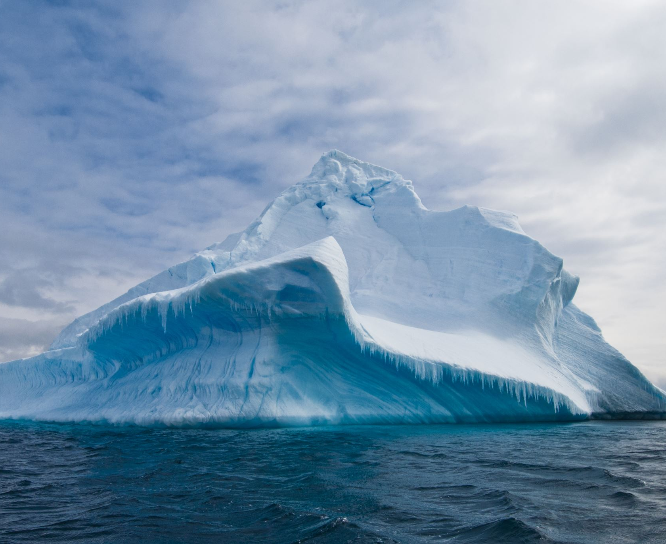
Climax
The top of the dramatic plot structure. The climax sometimes solves the conflict, but sometimes does not.

Slide 7
Falling Action
The main conflict starts to be resolved!

Slide 8
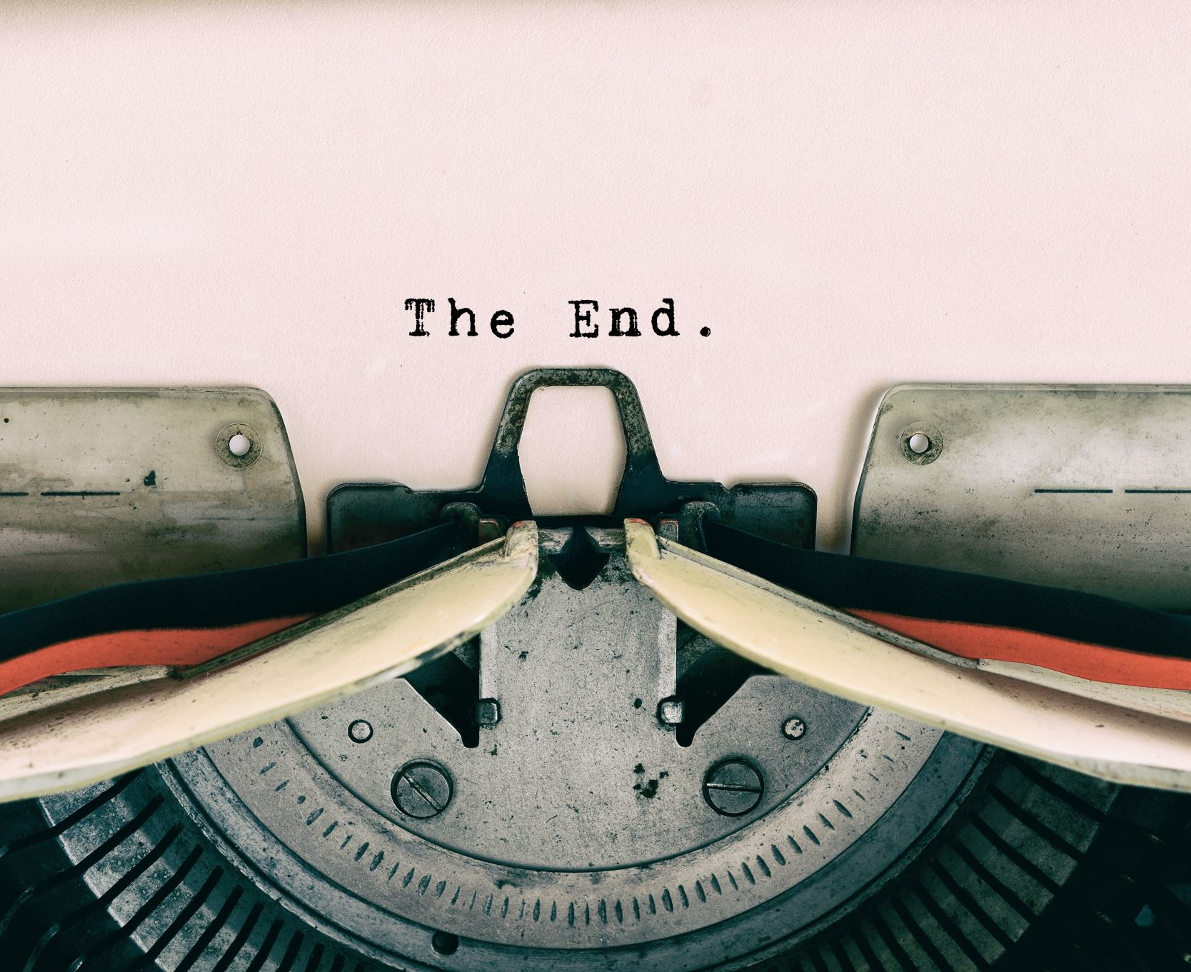
Resolution
The conclusion of the story where questions are answered, and any loose ends are tied.

Slide 9
Grab a piece of paper and a pen

Slide 10
Draw the arc

Slide 11
My Quarantine Scene:
When I had to leave my residence hall and stay at my boyfriend’s house for a couple of weeks until we got more news about the COVID-19 situation on campus
Climax
My partner and I got frustrated with each other because we had little space and was not able to do much besides be at home.
Rising Action
We couldn’t go anywhere because most places were closing due to COVID
We had one desk to share while trying to do classes online
My partner lives with their parents so, we spent most of our time in their room (Which isn’t the biggest)
Falling Action
We started to get into a routine of when each other would use the desk, do laundry, etc.
We started to go driving around town after doing work for a few hours
We walked outside a couple times in the week
Conflict
Love vs. Safety
Inciting Incident:
Quarantine during COVID-19
Resolution
I heard news from Winthrop and was able to get my belongs from Winthrop and return home for the remainder of the semester
Point of Attack:
Having to be confined in a room with my partner

Slide 12
My Quarantine Scene:
Climax
The Dramatic Plot Structure Graphic Organizer
Rising Action
Falling Action
Conflict
Inciting Incident
Point of Attack
Resolution

