Slide 1
Welcome Actors!
Please grab your Theatre Journals and take a seat!
Theatre Journal Writing Prompt for Today!
From your reading, write a definition of technique without using your book!
Today’s Date is Tuesday, April 6th, 2021

Slide 2
Vocabulary – Put on your Vocab Page!
Technique:
“Technique is a knowledge of the tools that may be used for certain craft and an understanding of how to apply these tools” (Bruder, 8).
Acting Technique (Vocab added on Monday!):
A technique that is used to approach acting in relation to a specific method
Notes:
Make sure students are writing these terms in their vocabulary section of their Theatre Journals

Slide 3
An Action Must…
Be physically capable of being done.
Be fun to do.
Be specific.
Have its test in the other person.
Not be an errand.
Not presuppose any physical or emotional state.
Not be manipulative.
Have a “cap.”
Be in line with the intentions of the playwright.
Notes:
Hand out Theorist/Acting Method Assignment Sheet

Slide 4
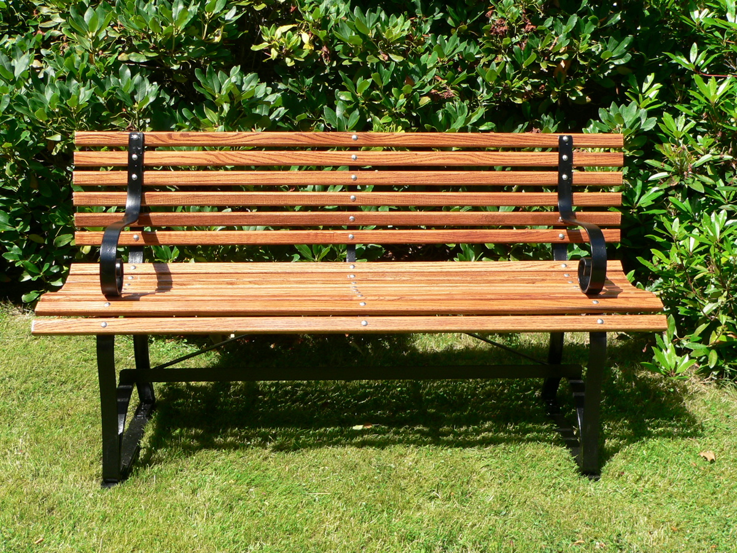
Park Bench Activity
This Photo by Unknown Author is licensed under CC BY-SA
Notes:
Hand out Theorist/Acting Method Assignment Sheet

Slide 5
Independent Work Time!
Let’s get started! Please use Volume 1 since music will be playing in the background while you work! I will be around to help with any questions that you may have!
Due Date: Next Monday! April 12th, 2021

Slide 6
Welcome Actors!
Please grab your Theatre Journals and take a seat!
Theatre Journal Writing Prompt for Today!
Review: What is one of the “an action must” points?
Today’s Date is Wednesday, April 7th, 2021

Slide 7
Character Action Map
What is the character literally doing?
Be as literal as possible!
What is the essential action of what the character is doing in this scene?
The actual physical action that you will perform
What is that action like to me? It's as if...
Allows for an actor's imagination and helps the actor gain a fuller understanding of the action they have chosen for a given scene.
Notes:
Hand out Theorist/Acting Method Assignment Sheet

Slide 8
Scenes!
Click Here to Choose a Scene!
Notes:
Hand out Theorist/Acting Method Assignment Sheet

Slide 9
Welcome Actors!
Please grab your Theatre Journals and take a seat!
Theatre Journal Writing Prompt for Today!
Define: Objective and Tactic. How do you think these relate to action?
Today’s Date is Thursday, April 8th, 2021

Slide 10
Notes:
Hand out Theorist/Acting Method Assignment Sheet

Slide 11
Vocabulary – Put on your Vocab Page!
Action
“…the physical pursuance of a specific goal” (Bruder, 13).
Objective
An objective is something that the character wants
Tactic
A tactic is how the character gets what they want
Notes:
Make sure students are writing these terms in their vocabulary section of their Theatre Journals

Slide 12
How did you do?
Objective
An objective is something that the character wants
Action
An action is how you physically achieve your objective
Tactic
A tactic is how the character gets what they want
What do these three terms have in common?
They are used to create a character!
Notes:
Hand out Theorist/Acting Method Assignment Sheet

Slide 13
Scenes!
Find the objective, action, and tactic for your character!
Click Here to Choose a Scene!
Notes:
Hand out Theorist/Acting Method Assignment Sheet

Slide 14
Welcome Actors!
Today is a WORKDAY! Please use it wisely!
Volume 1 Please!
Today’s Date is Friday, April 9th, 2021

